Slide 1
The 8 Tile Puzzle
An Exercise in Reinforcement Learning!

Slide 2
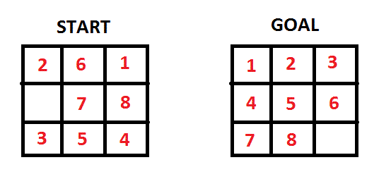
The basics of the game
3x3 game board containing tiles 1 through 8 and an empty space.
Only the tiles adjacent to the empty space are movable.
The goal of the game is to organize the tiles such that they look like the picture on the right below.

Slide 3
Conceptualizing the problem
Create a matrix as the representation of the game board at all times.
8 tile game has 4 possible moves at most- up, down, left, right. Often the empty space will be bordered by the boundary of the game space and only have 2 or 3 possible moves.
The search tree for the 8 tile game has its starting node as the initial puzzle to be solved, and the successors are the possible moves that can be performed given the game board.
Not too different from the Pacman project overall

Slide 4
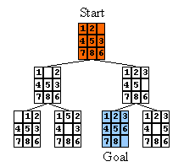
Types of Search & Search Tree
Goal of the project is to implement an 8 tile puzzle solver that can solve search tree with DFS, BFS, UCS, A*.
Search tree for 8 tile puzzle can be surprisingly complex- not very difficult to create a puzzle that needs to expand thousands of nodes to find goal state.
For the cost of each node, our program takes the depth of the puzzle as its cost. The heuristic used for A* search is the manhattan distance of a tile from its current location to its goal location.

Slide 5
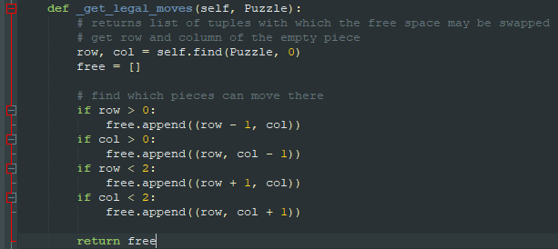
Puzzle expansion order
The order in which the possible successor puzzles are processed has huge implications on which algorithm between DFS or BFS will be more efficient at solving the puzzle.
In our program’s case, the order in which the puzzles are appended is as follows; move empty space left, move empty space down, right, then up.
A maximum of four nodes can be created per each parent puzzle node, which leads to an exponential increase in nodes to expand.

Slide 6
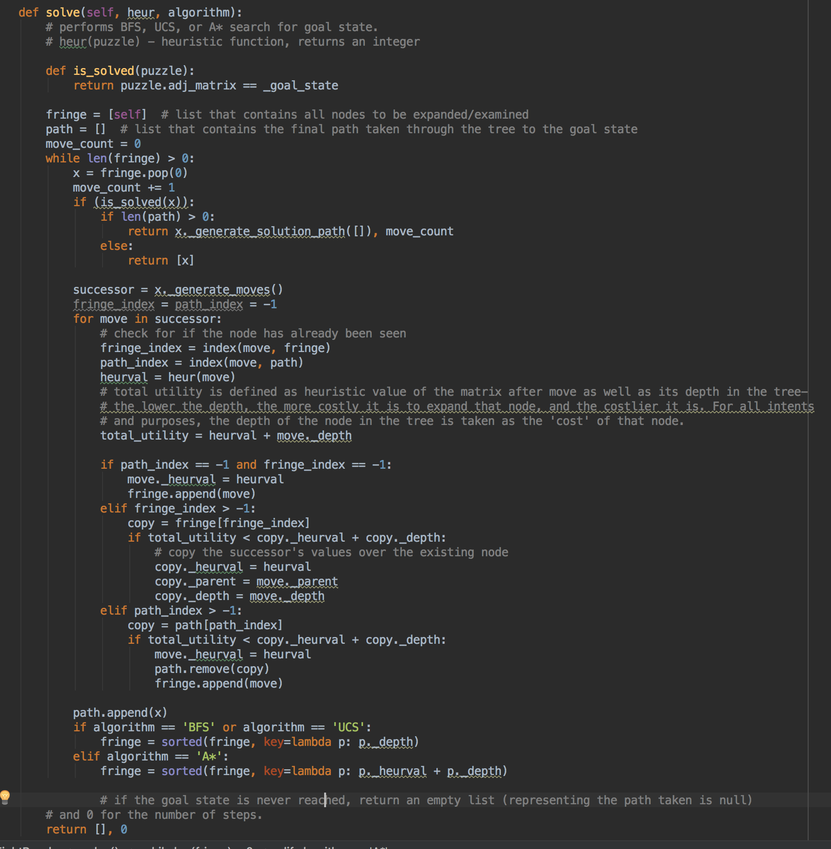
Current Solution
Every search algorithm is run
through solve method
We utilize various data Structures for different
Searches(Stack, Priority Queue, etc.)
A* search utilizes Manhattan Distance as heuristic
Currently UCS and BFS are equal to each other,
since we are using constant cost for every move

Slide 7
Current Issue
After implementing BFS and A* searches
We ran into problem with DFS.
Depending on the board set up it might solve the problem.
However in some cases DFS takes either too long to compute the
solution or even crashes the program.

Slide 8
Conclusion
In the majority of test A* proves to be the most effective way to reach the solution.
BFS and UCS are the second as expected
With DFS we need to investigate more if the Algorithm is very inefficient or we haven’t implemented it correctly.

